Slide 1

Xcode Storyboards and Interface Builder
Week2
2022/3/2

Slide 2

Let Review The ”I am rich” APP

Slide 3

So…Today our work is to build an APP and “doing nothing”

Slide 4
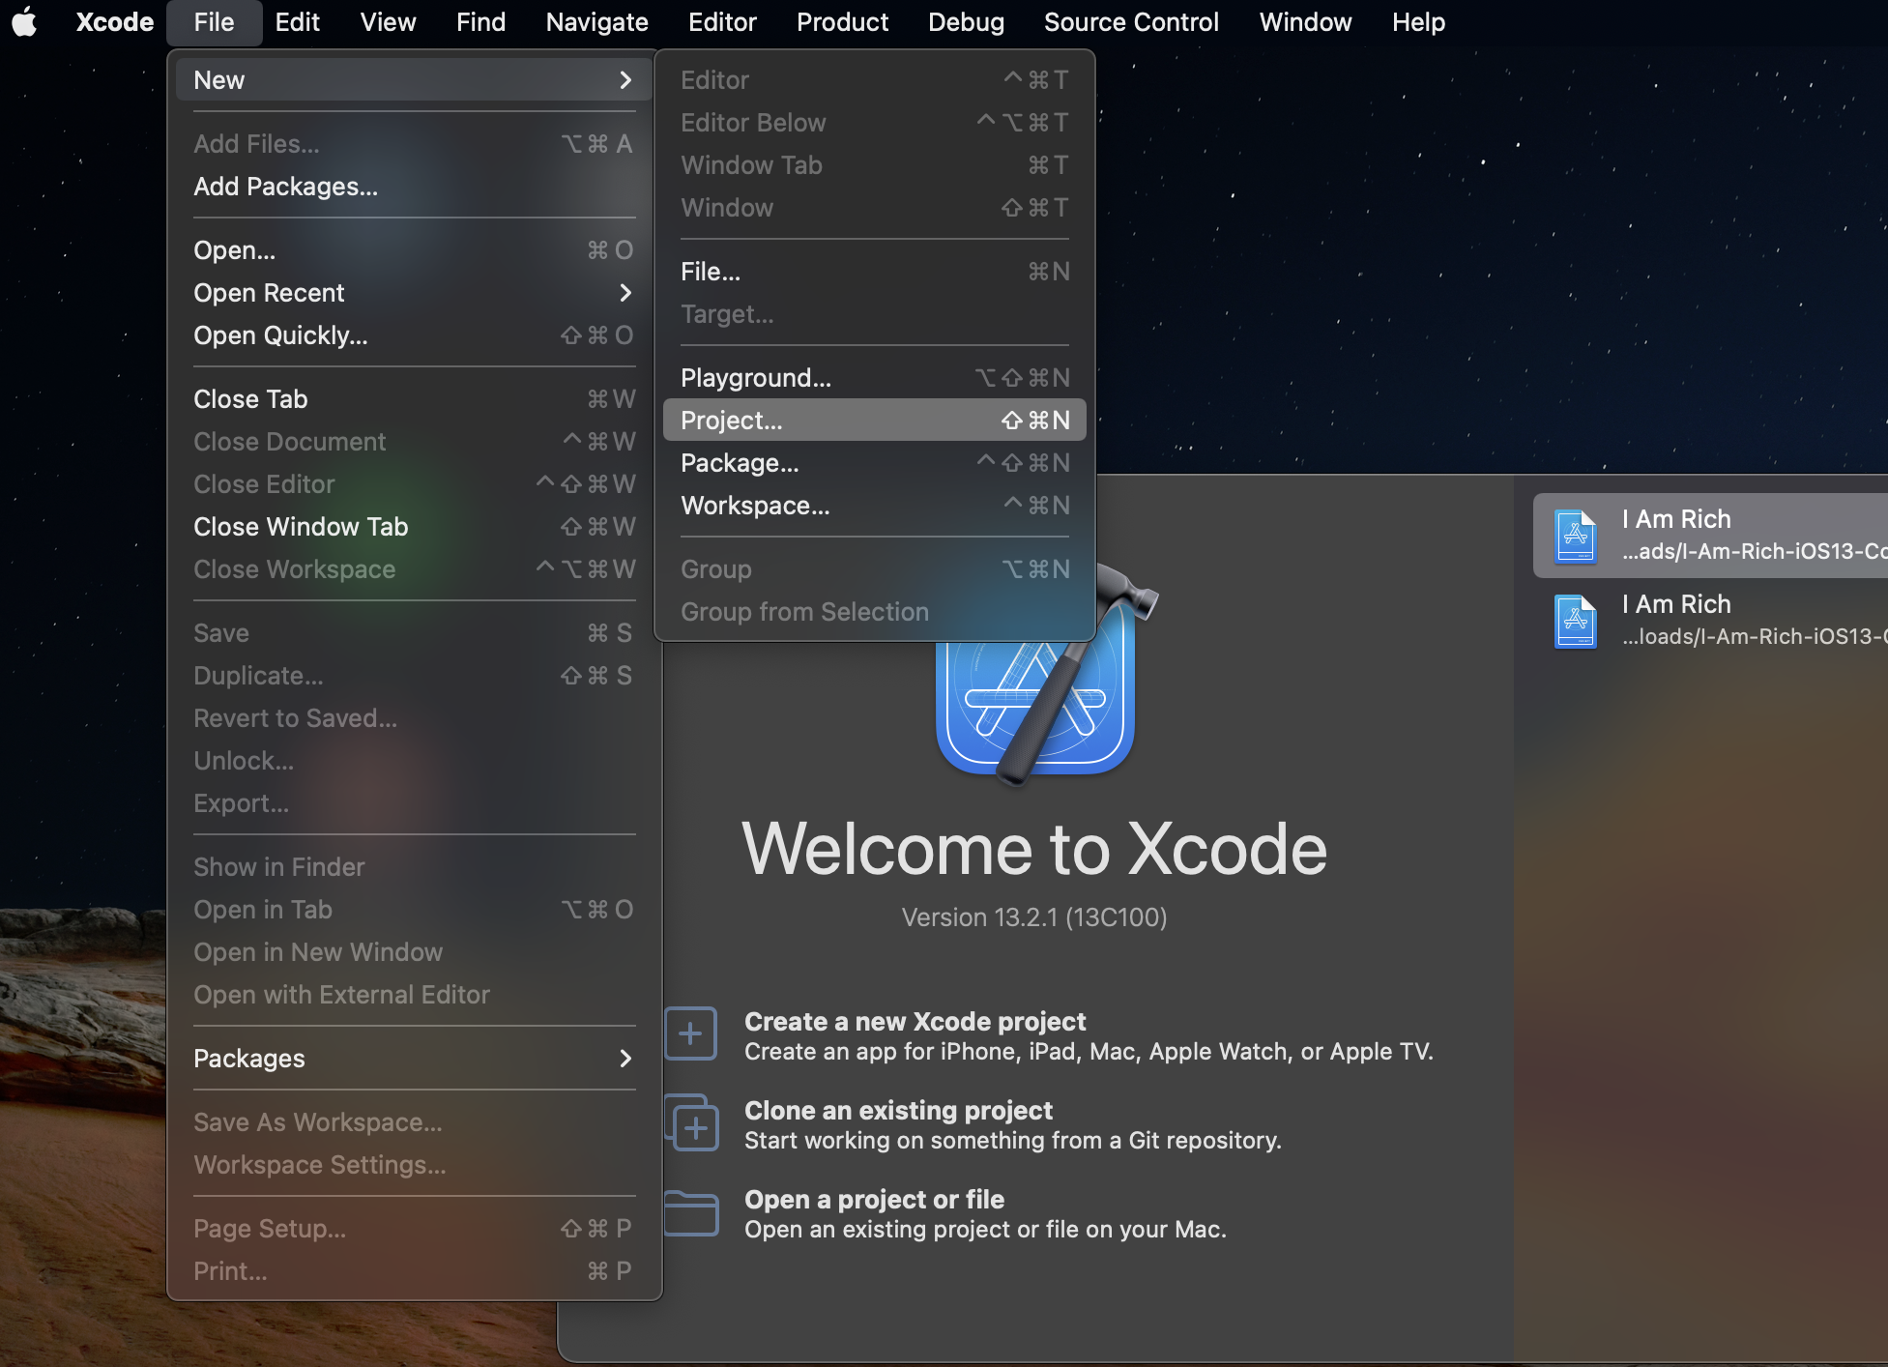
Create a Brand New Xcode Project
You can create a new project by clicking the button from the welcome screen
You can also go to the File-> New -> Project to do the same thing

Slide 5
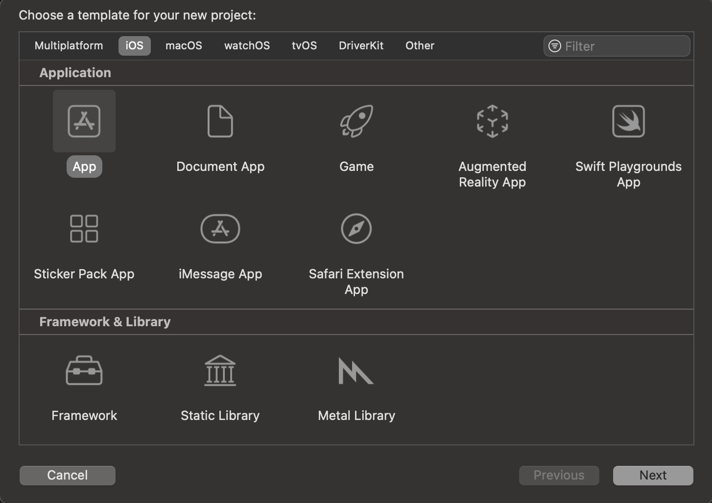
Choose the Template for The New Project
We get different tabs for creating iOS, macOS, watchOS, tvOS and other apps
We want an iOS app now but you’re free to modify it as you need to do.

Slide 6
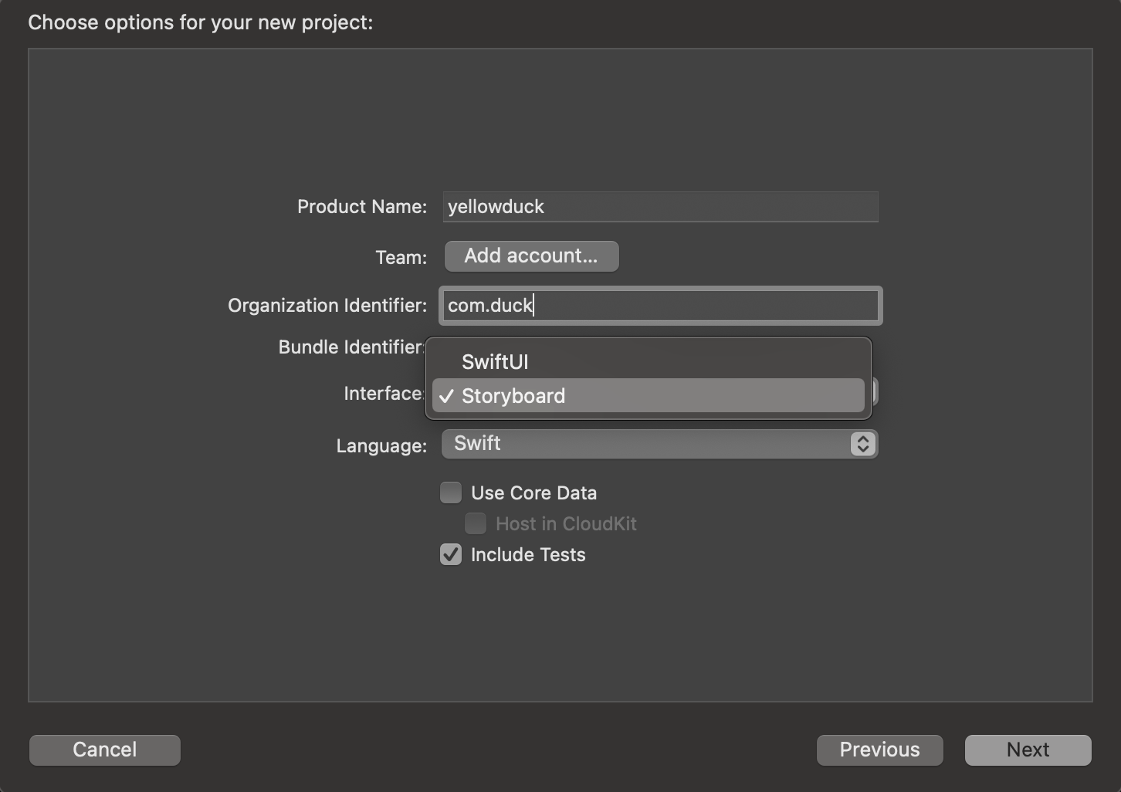
Choose Options for Your Project
First type the name, organization identifier in blanks.
the most important thing is to change the interface option from “SwiftUI” to “Storyboard”

Slide 7
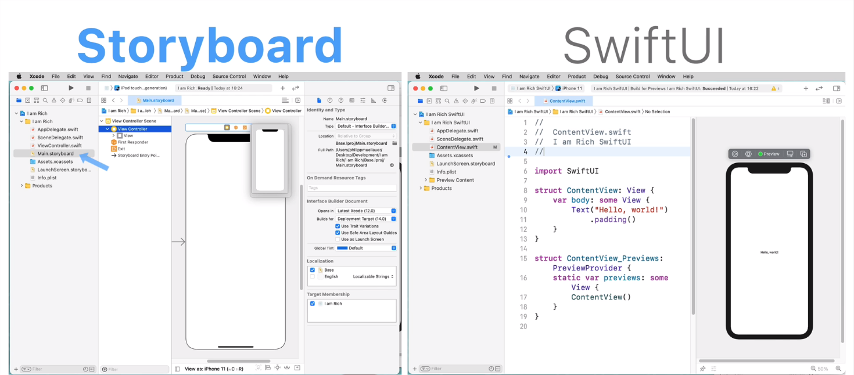

Slide 8
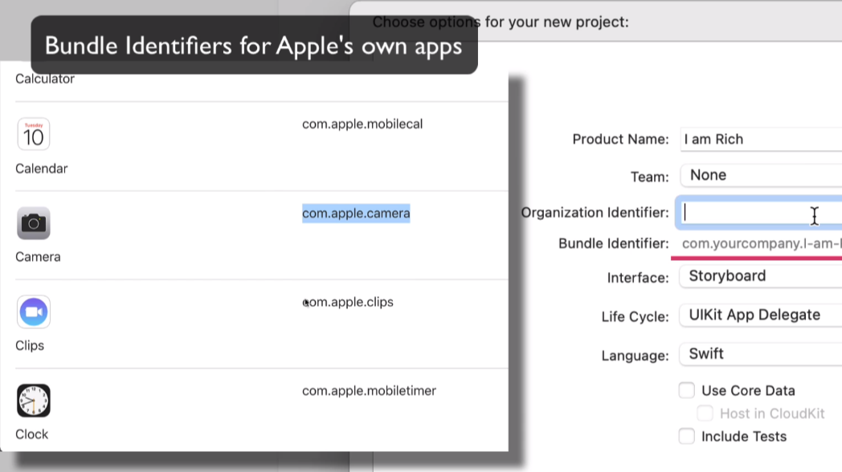
Bundle Identifier

Slide 9
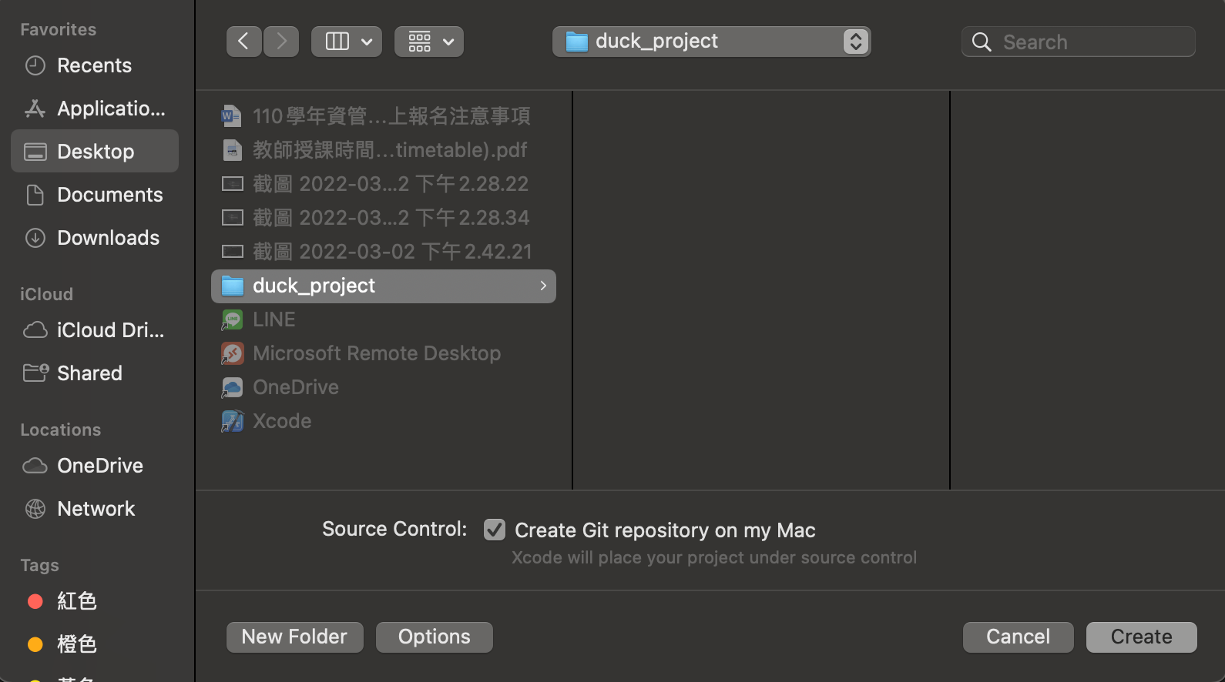
Choose the Path to Store The Project

Slide 10
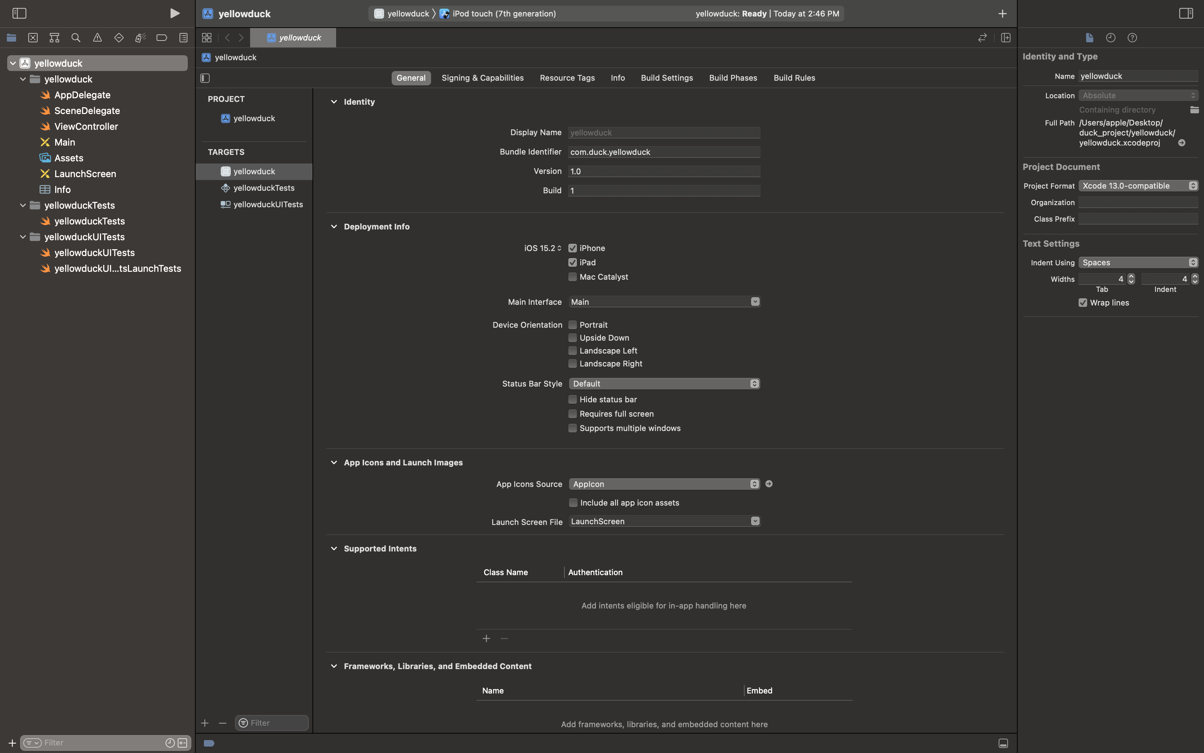
Congratulation!

Slide 11
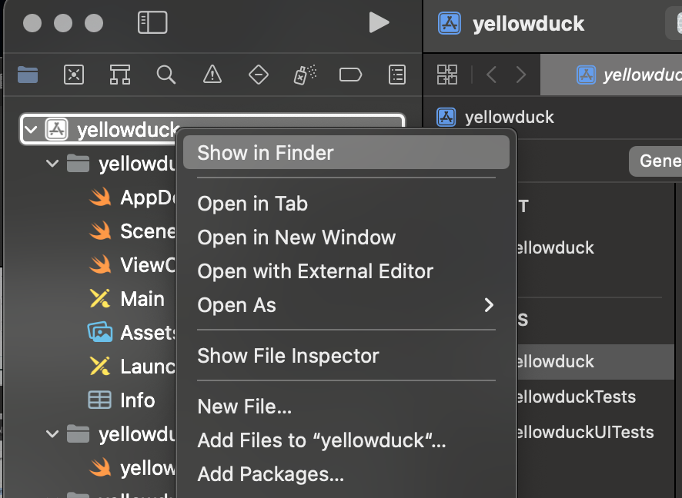
Find Your Project Folder
Click on “Show in Finder”, at which point it's going to show you where it is on your computer.

Slide 12
Let‘s make some changes on your project

Slide 13
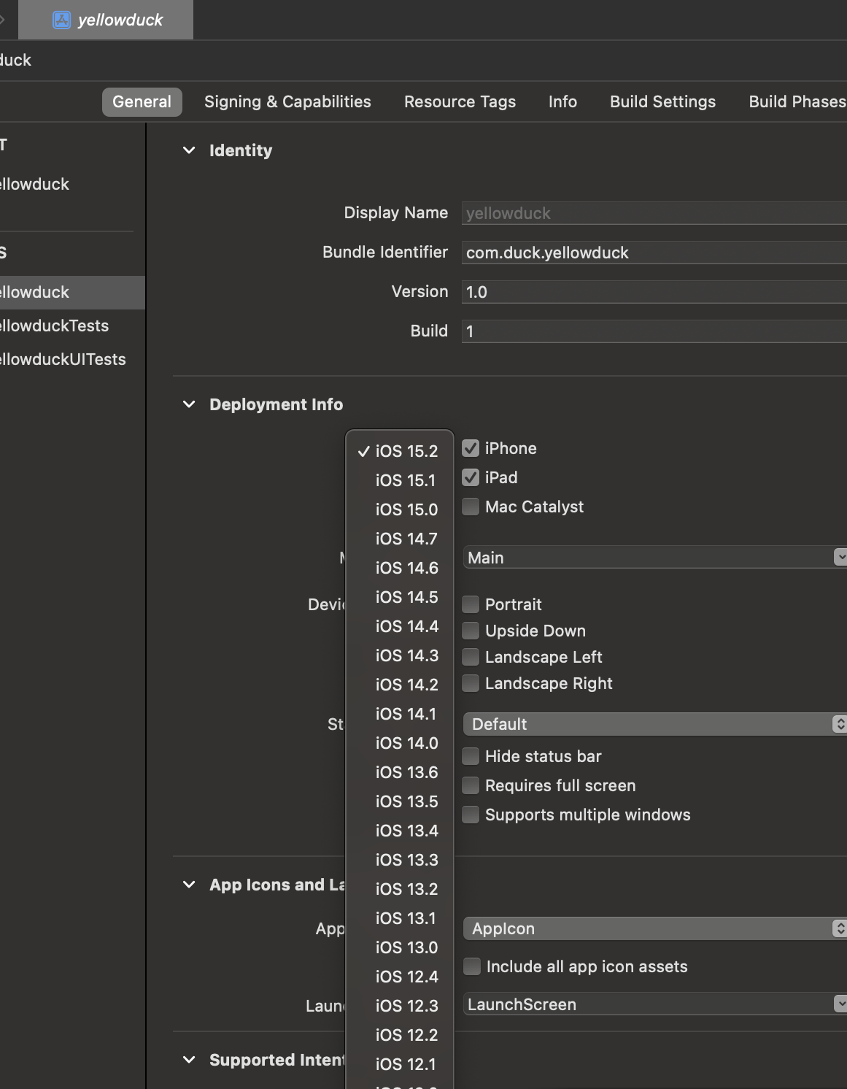
General Setting
You can change things such as the version, for example: how our app is going to be deployed, and when it's run, where is it going to be running on?
Please keep in mind that this is going to be the minimum version that you want to deploy.

Slide 14

In most cases, you'll be keeping these settings as the defaults, and we'll be doing most of our important work inside the swift and storyboard files.

Slide 15
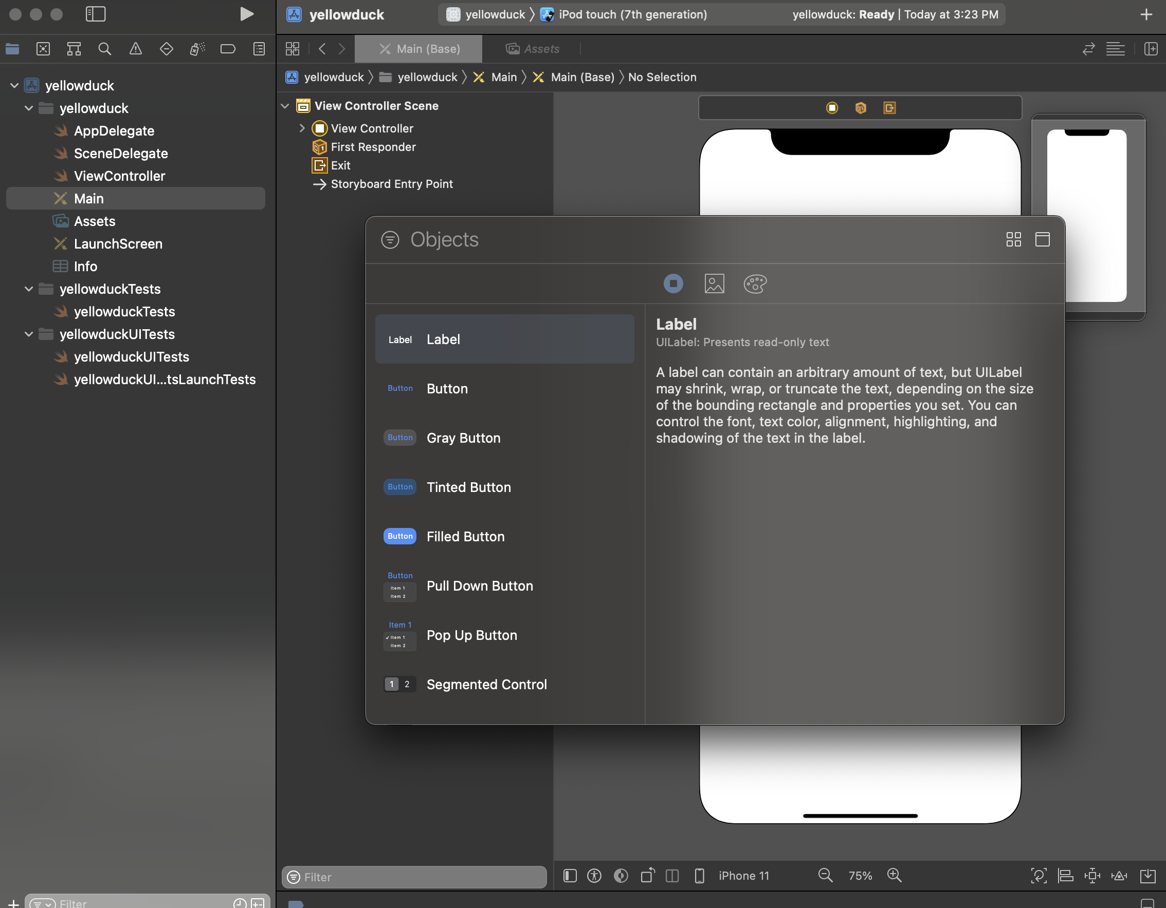
Storyboard
add components
The main.storyboard is where you'll be designing most of your app.
You can access various components, things such as labels, buttons, all of the default iOS components and you can simply drag and drop them onto the screen like so.

Slide 16
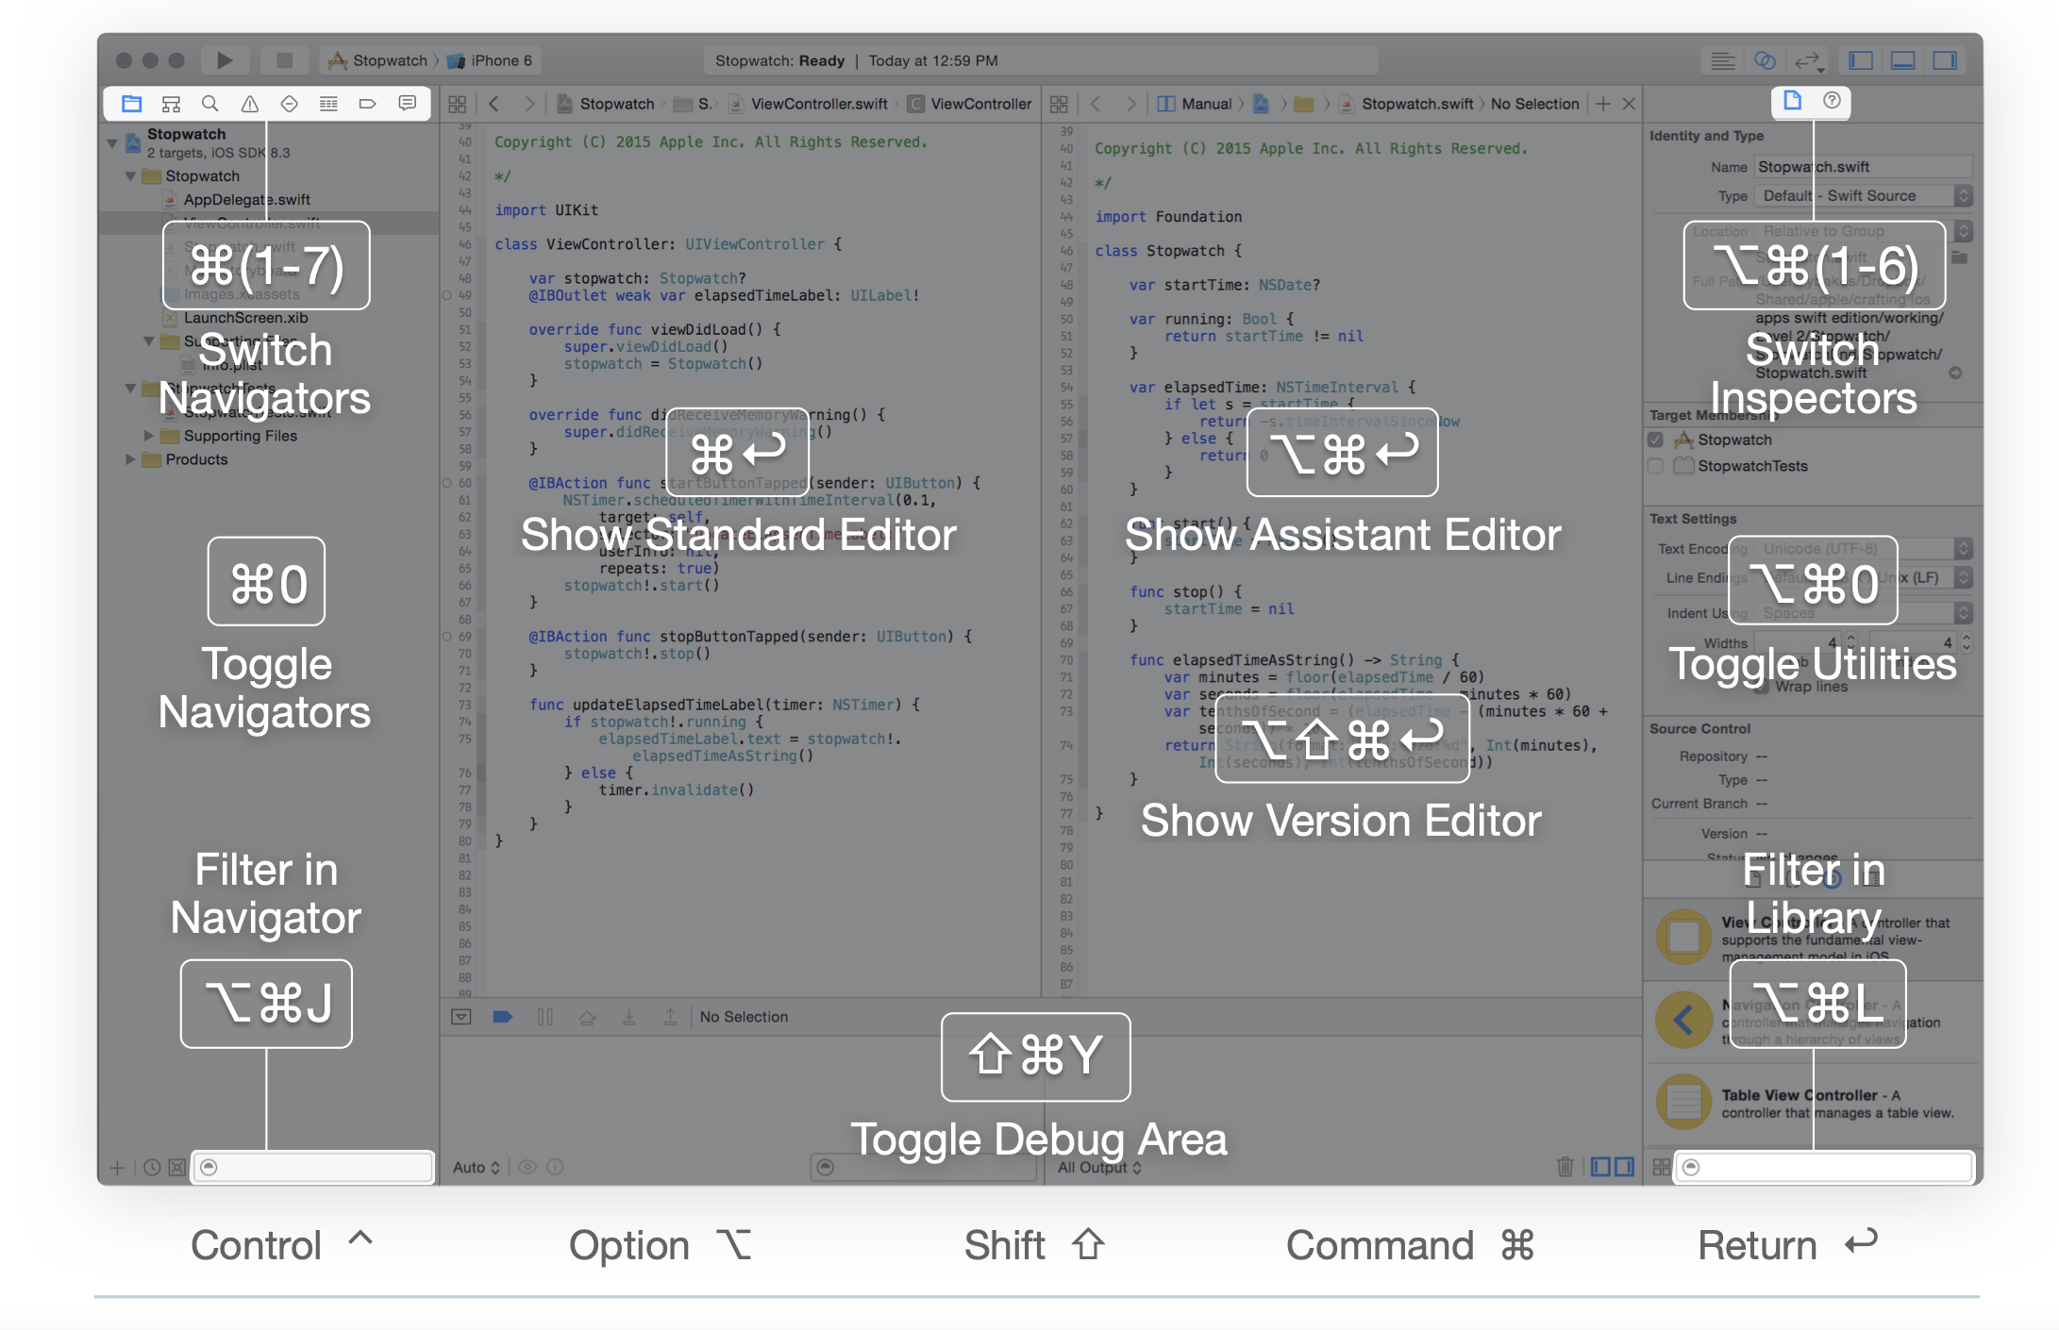
Xcode Keyboard Shortcuts
You can find the information here:
https://swifteducation.github.io/assets/pdfs/XcodeKeyboardShortcuts.pdf

Slide 17
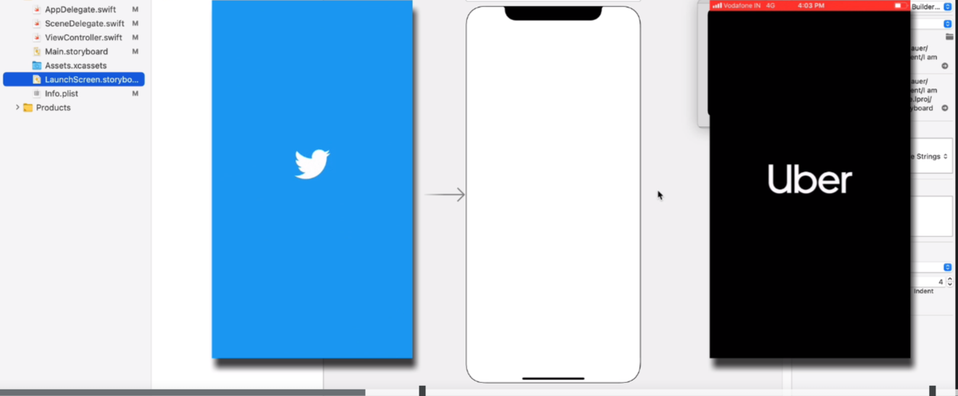
Main and LaunchScreen

Slide 18
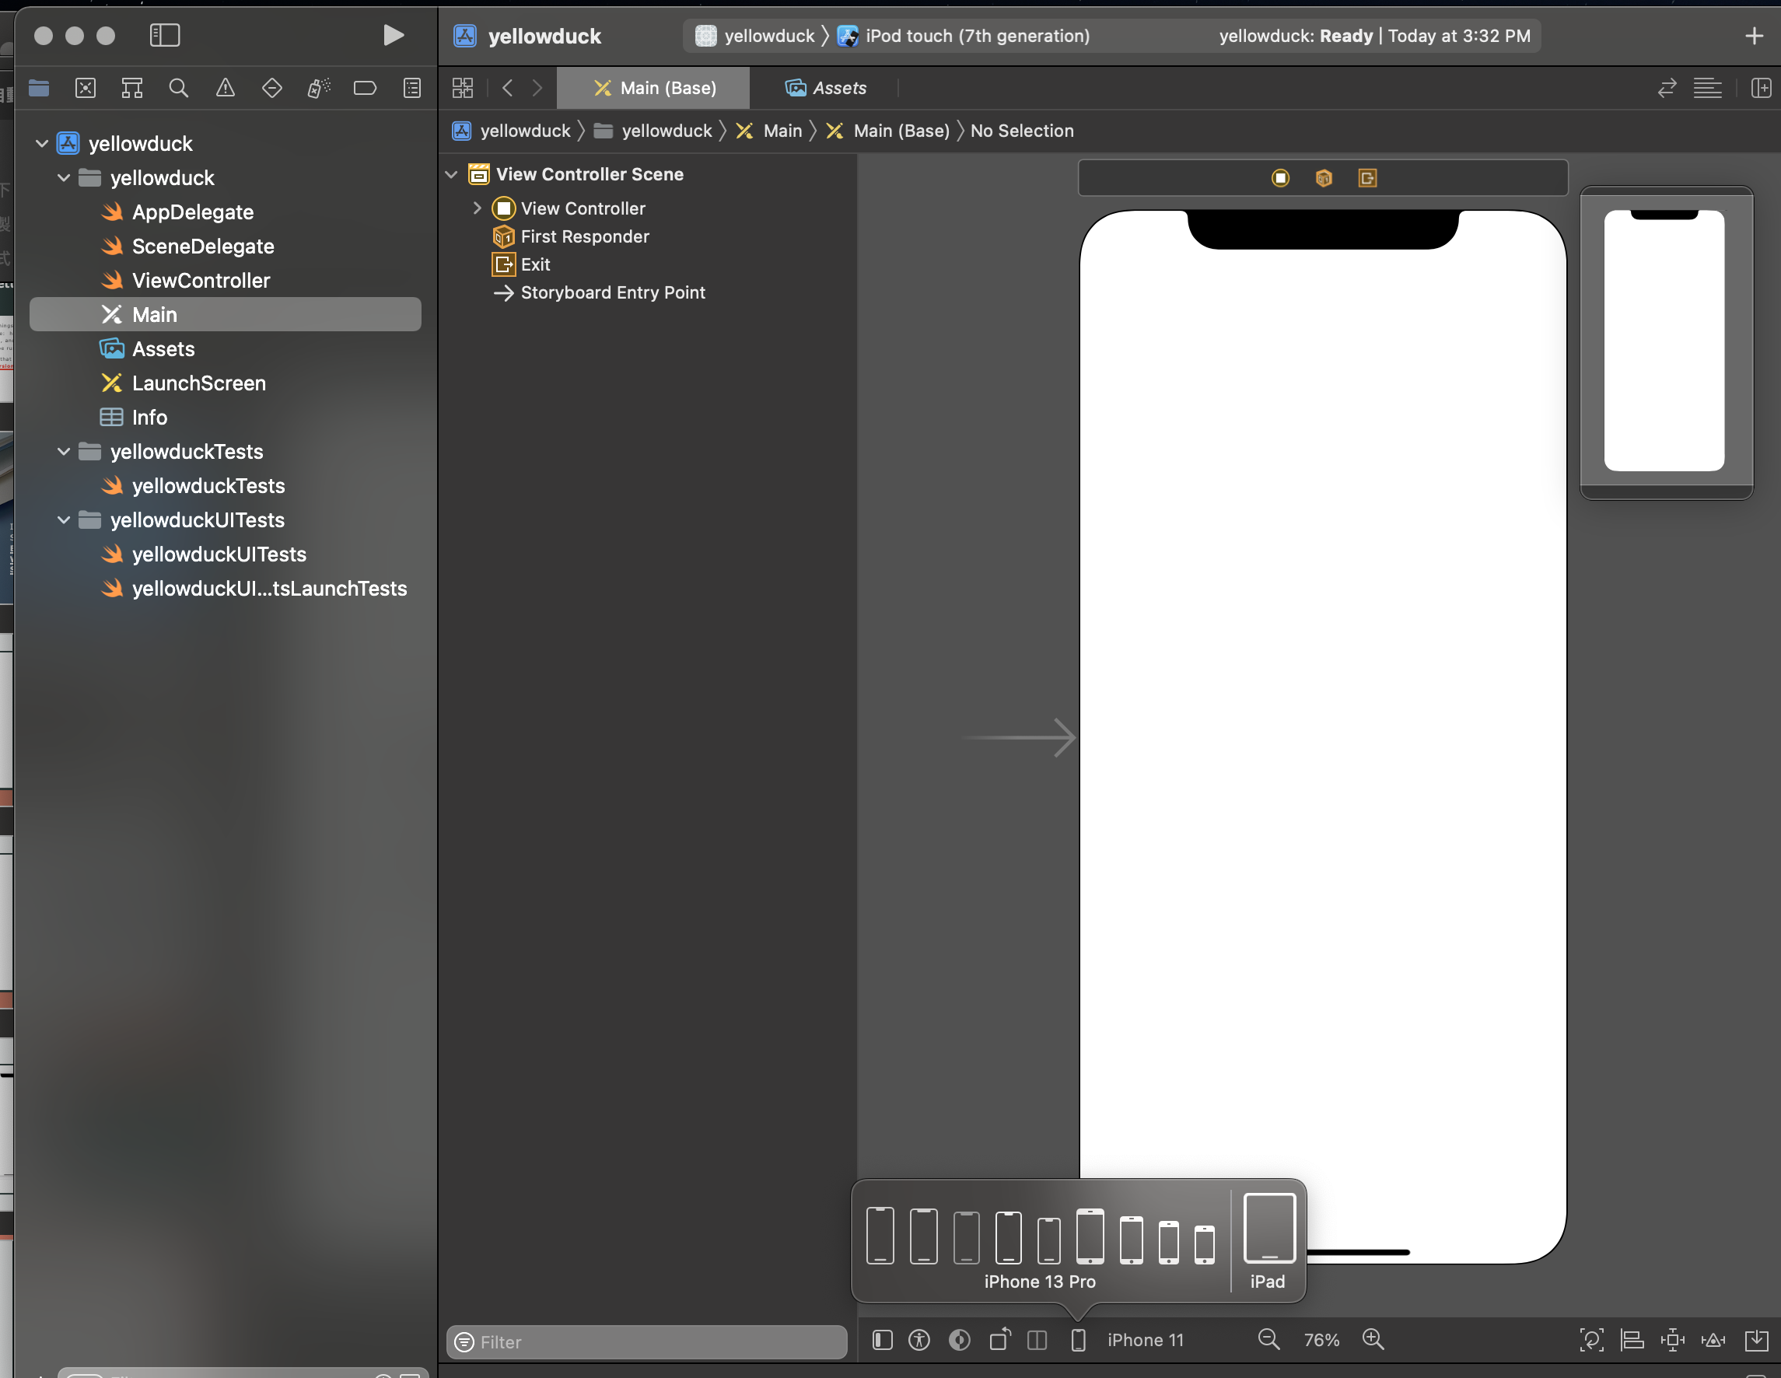
Main.storyboard
You'll see the bottom side followed by an iPhone model, if you click on it, it starts giving you various options so you could change the type of device and notice how it doesn't have every single device.
You've also got the selection of the light and dark modes as well as the landscape and portrait and you can change these as you're designing to quickly see what your design would look like on each of these different settings.

Slide 19
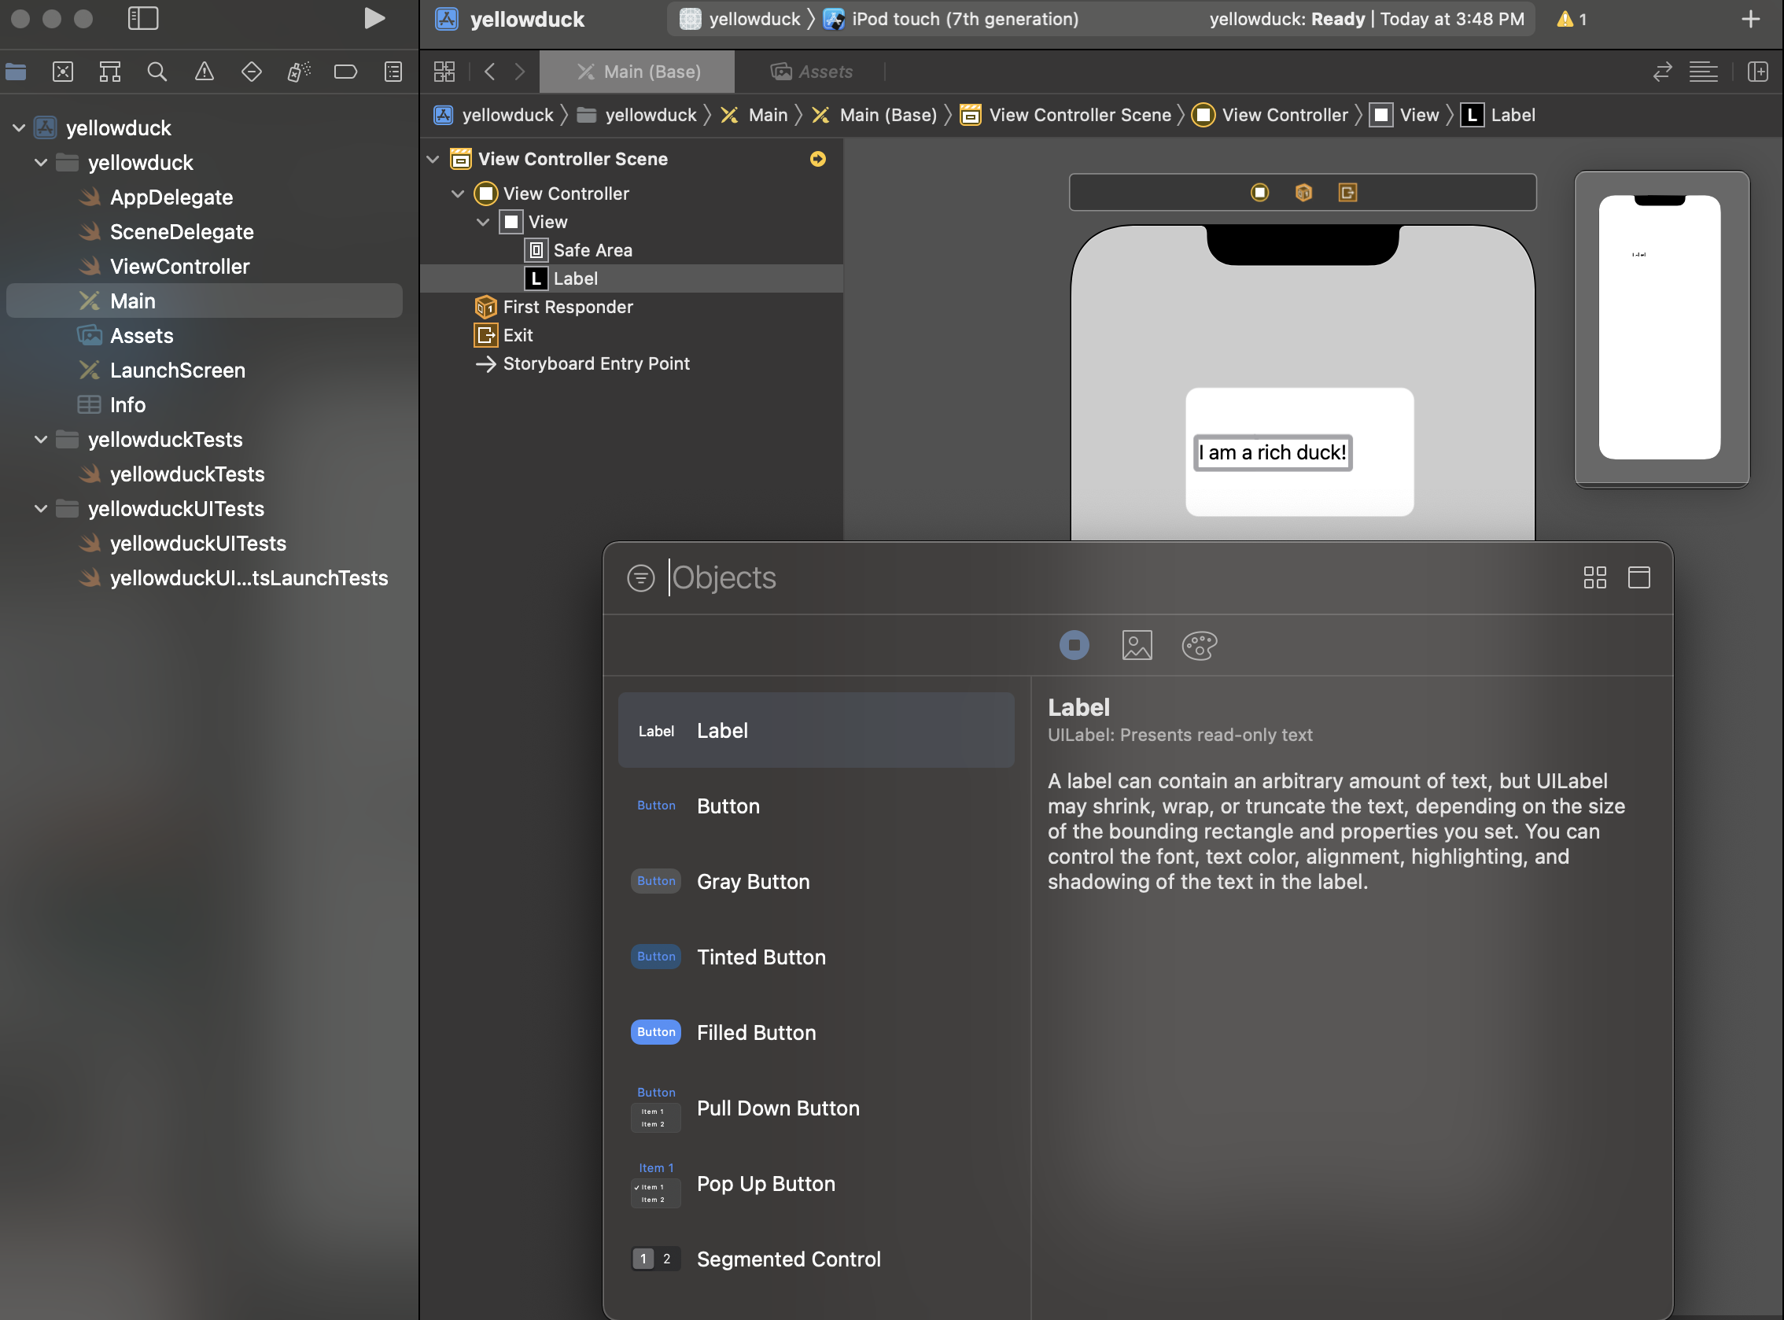
Add A Label
Click and select the label and it tells you a little bit about what this component is and what it does.
Click and drag it onto the screen.

Slide 20
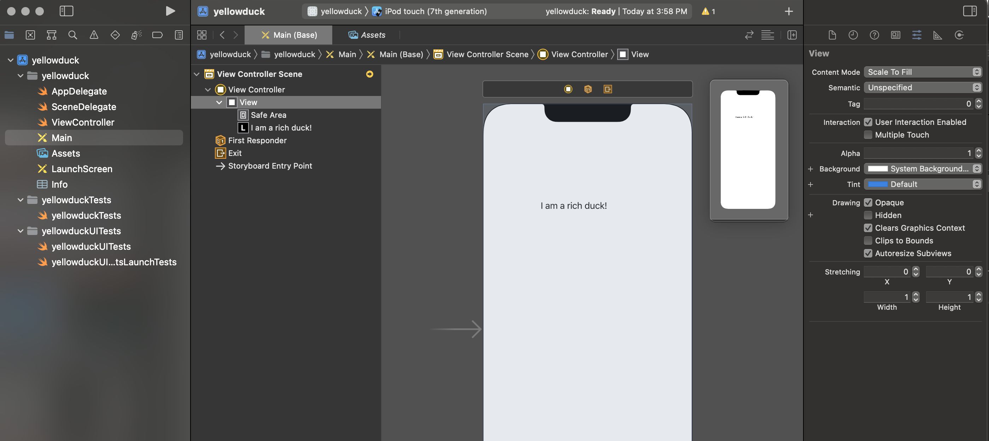
View
The document outline we have the label, which we created just now, and it's sitting inside something called a view.
The view is basically what you see in the background and we can change it by, again, selecting it in the document outline and going to the attribute inspector.
You can change some setting here, for example, the background color.

Slide 21
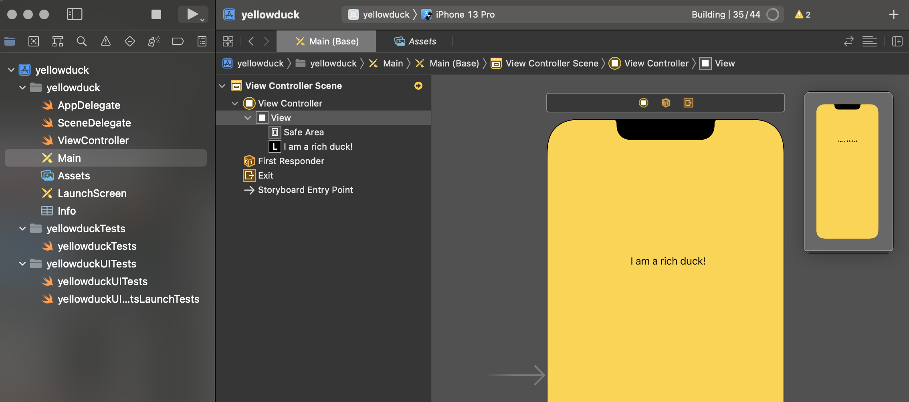
Try to Run Your First App!
run
select your device for simulator

